Slide 1
SMS Spamming Application
Presented By:
Ibrahim Irfan CSU-F15-104 Bilal Ahmed CSU-F15-105

Slide 2
Contents
Introduction
Goals and Objectives
Problem Definition
Problem Solution
Literature Review
Research Questions
Evaluation Metrics
Features
System Requirements
Activity Plan
Conclusion
References

Slide 3
Introduction
SMS spamming application is a project that will facilitate the prevention of unwanted SMS messages or pop up ads to appear on a user’s Android smartphone.
Users will be able to download a free of cost app from the Play Store that will allow them to avoid unwanted messages or spams and block any ads that can harm their device.

Slide 4
Goals and Objectives
Reduce the possibility of spams and pop up ads to appear on smartphones
Design and develop an app that gives smartphone users the chance to avoid spams.
Make it easier for Android users to keep their data safe and secure on their smartphone devices.

Slide 5
Problem Definition
For quite some time now, many individuals all around the world do most of their work on their Android smartphones and have become very fond of the technology.
In the modern era, most users keep all their data such as contacts, messages, accounts (usernames and passwords), and images on their Android device.
However, recently a lot of smartphone users have had to deal with the frustration of unwanted SMSs, spams and pop ads interfering in their work.
Most people don’t even know the origin of these spams and what harm they may bring. These spams are not only irritating but can also harm your device in many ways.

Slide 6
For example, these spams and pop up ads can leave a virus on your device or even steal extremely important and private information from your device if you choose you click ‘yes’ to these spams.

Slide 7
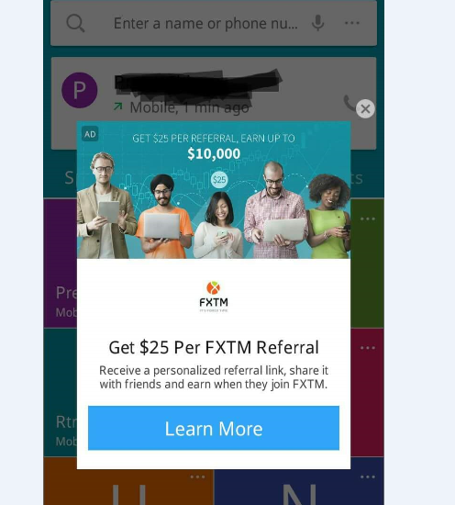
Pop-Up Ads
Unwanted Spams

Slide 8
Problem Solution
In this project, we will provide smartphone users the means to keep their phones and whatever data is on them safe from these harmful spams and pop up ads.
Users will be able to block any unwanted ad or window from appearing and disrupting their work.
Smartphone users can also easily keep their personal information safe and secure and prevent it from being stolen by those individuals who spread these spams and pop up ads.
With this app, users will be able to identify a spam or pop up ad and get rid of it instantly with the click of a button.

Slide 9
Literature Review
Name | Methodology | Strengths | Weaknesses
Lutfun Nahar Lota, and B M Mainul Hossain 2017 | Developing apps for SMS spam detection Research Questions Developing android based application | The current approaches towards building apps for SMS spam detection yielded satisfactory results. | These apps are no longer as efficient as they used to be and are being replaced by newer ones.

Slide 10
Research questions
How to detect and block an SMS spam or a pop up ad?
How block multiple unwanted SMS messages and ads?
What other approaches are feasible towards SMS spamming detection apps?

Slide 11
Evaluation Metrics
Question | Problem | Metric
Q1 | Binary | Precision
Q2 | Multi Class | Precision
Q3 | Feature Extraction | Gathering Information

Slide 12
Features
Free of cost
No regional restriction
Compatible with all devices
User friendly

Slide 13



System Requirements & Tools
We will be using the following tools to develop and design our application:
Android Studio
Microsoft Visual Studio 2015
Eclipse for Java coding

Slide 14
Activity plan
Start
Gather Requirements
Gather Data
Design
Coding
Testing/Debugging
End

Slide 15
Conclusion
By the end of this project, Android smartphone users should have the opportunity to download an app from the Google PlayStore which will be free of cost that will assist them in keeping their important information safe and secure on their phone and prevent harmful spams and pop up ads from appearing on their phone and stealing personal information. It will also provide the means to identify a spam or pop up ad and get rid of it.

Slide 16
References
[1] Lutfun Nahar Lota. And B M Mainul Hossain.,2017. A Systematic Literature Review on SMS Spam Detection Techniques.
[2] Shafi Muhammad Abdul Hamid., Muhammad Shafie Abd Latiff. And Haruna Chiroma., 2017. A Review on Mobile SMS Spamming Filtering Techniques. https://ieeexplore.ieee.org/document/7851079/authors#authors.

Slide 17
Thank You

